Slide 1
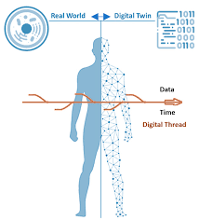
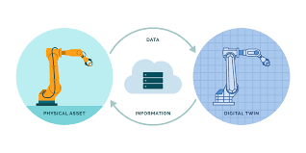
Digital twin
A digital twin is a virtual model designed to accurately reflect a physical object.

Slide 2

An example of digital twin, a wind turbine—is outfitted with various sensors related to vital areas of functionality. These sensors produce data about different aspects of the physical object’s performance, such as energy output, temperature, weather conditions and more.
Digital twin
This data is then relayed to a processing system and applied to the digital copy.

Slide 3
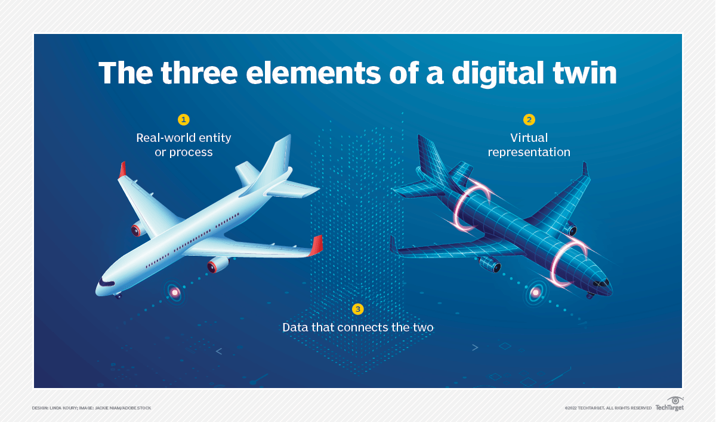
A digital twin can also be defined as a virtual representation of a real-world entity or process. It is composed of the following three elements:
a physical entity in real space;
the digital twin in software form; and
data that links the first two elements together.

Slide 4
Difference between digital twin and simulations
Although simulations and digital twins both utilize digital models to replicate a system’s various processes, a digital twin is actually a virtual environment, which makes it considerably richer for study.
The difference between digital twin and simulation is largely a matter of scale: While a simulation typically studies one particular process, a digital twin can itself run any number of useful simulations in order to study multiple processes..
The differences don’t end there. For example, simulations usually don’t benefit from having real-time data.
But digital twins are designed around a two-way flow of information that first occurs when object sensors provide relevant data to the system processor and then happens again when insights created by the processor are shared back with the original source object.

Slide 5
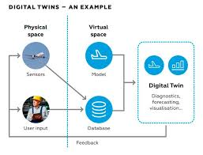
Essential properties related to digital twin
A digital twin functions as a proxy for the current state of the thing it represents. It also is unique to the thing represented, not simply generic to the category. Moreover, the digital twins of two seemingly identical products will not usually be identical.
While many digital twins have a 2D or 3D computer-aided design (CAD) image associated with them, visual representation is not a prerequisite. The digital representation, or digital model, could consist of a database, a set of equations or a spreadsheet.
The data link, often but not necessarily two-way, is what differentiates digital twins from similar concepts. This link makes it possible for users to investigate the state of the object or process by querying the data, and for actions communicated through the digital twin to take effect in its physical counterpart.

Slide 6
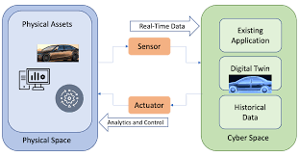
three key aspects of the digital twin technology
Synchronization is about making sure the digital twin and the represented entity mirror each other as closely as possible.
The frequency, or speed, at which data gets updated in a digital twin can vary enormously, from seconds to weeks to on demand, depending on the purpose.
Fidelity is the degree of precision and accuracy of the virtual representation and the synchronization mechanism.

Slide 7
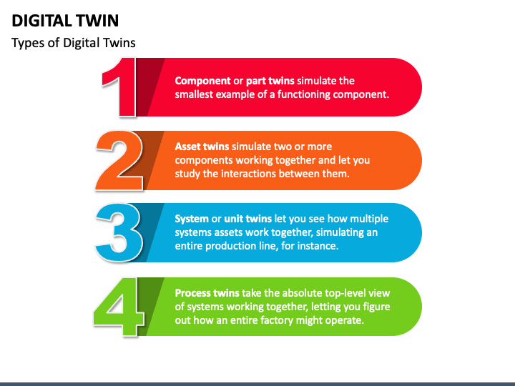
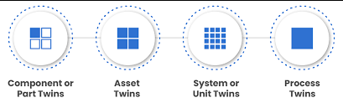
Types of digital twins

Slide 8
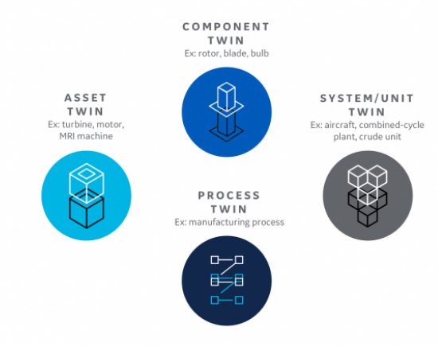
Types of digital twins

Slide 9
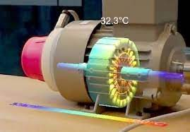
Component twins/Parts twins
Component twins are the basic unit of digital twin, the smallest example of a functioning component. Parts twins are roughly the same thing, but pertain to components of slightly less importance.

Slide 10
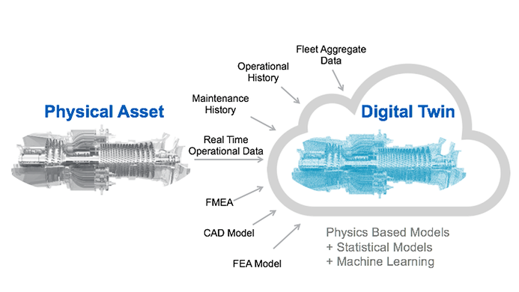
Asset twins
Asset twins (product). Two or more components whose interaction is represented in the digital twin.

Slide 11
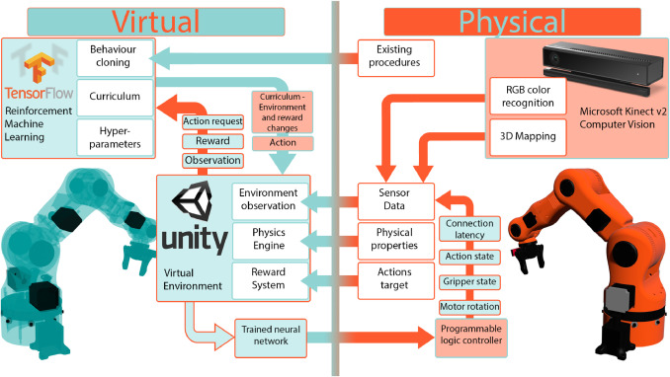
System twins
System twins (unit). Assets assembled into a complete, functioning unit.

Slide 12
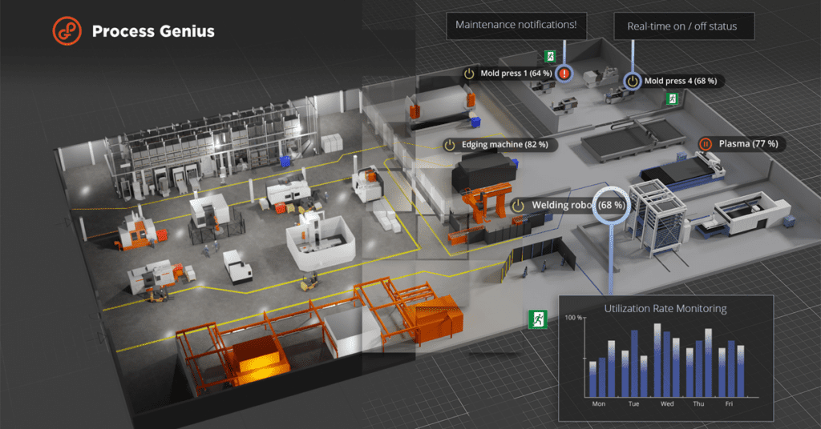
Process twins
Process twins. Systems working together to serve a larger goal.

Slide 13
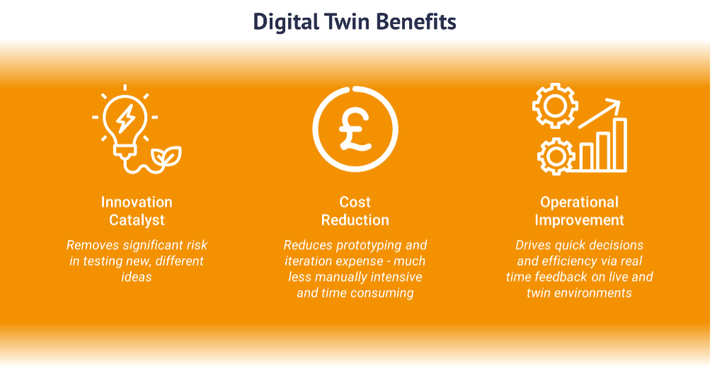
Benefits of digital twins
Because they're virtual, digital twins can reduce the cost and risk of having to work on the physical things they represent.
improved operational efficiency from having more timely data and faster, more effective production;
more effective and less expensive R&D from replacing physical prototypes, which can be expensive and hard to modify, with virtual prototypes that are more flexible and produce more data;
longer uptime for equipment because maintenance issues can be investigated in a single digital twin instead of having to shut down all the equipment to isolate a problem;
improved product end-of-life processes, such as refurbishment and recycling, thanks to more accurate information about the age and contents of a product.

Slide 14
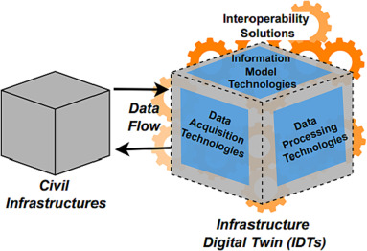
Digital twin interoperability
To be useful, digital twins must work in a variety of enterprise applications.
While they usually start in CAD and PLM, some digital twins are also managed in ERP and material requirements planning (MRP) software.
ERP and MRP store the bill of materials (BOM), a comprehensive inventory of the materials and parts needed to make a product and typically a major contributor of digital twin data. ERP and MRP together also run many of the supply chain and production processes that go into manufacturing a product; along the way, they collect much of the data that goes into the digital twin.
Another common source of digital twin data is the manufacturing execution system (MES) that many companies use to monitor, control and optimize production systems on the factory floor.

Slide 15
Challenges of digital twins
Organizations looking to develop digital twins face other daunting hurdles. Here are six of the biggest digital twin challenges:
Data management. Data cleansing is often needed to make data from a CAD model or IoT sensor usable in a digital twin. A data lake might need to be established to manage the digital twin data and perform analytics on it. Deciding who owns the data is another problem.
Data security. Digital twin data is timely and mission critical, but it also travels through several networks and software applications, which makes securing it at every stage challenging.
IoT development. As the preferred data source for most of the real-time and historical data about an entity or process, IoT sensors are usually a basic requirement of digital twins. Implementing IoT presents big challenges in network infrastructure and storage capacity, device and data security, and device management.

Slide 16
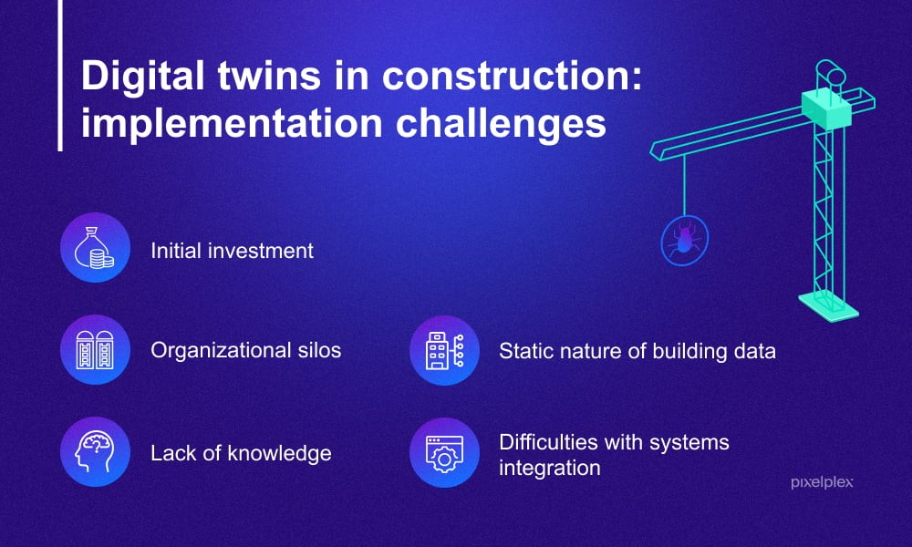
Challenges of digital twins

Slide 17
Challenges of digital twins
Organizations looking to develop digital twins face other daunting hurdles. Here are six of the biggest digital twin challenges:
System integration. Digital twins often begin life in CAD software but get more use in PLM, where they're used in post-sale services, such as performance monitoring and equipment maintenance. Numerous CAD and PLM software vendors have one-to-one integrations, but it isn't always adequate and smaller vendors may have no built-in integration.
Supplier collaboration. The numerous participants in a supply chain must be willing to share information from their own production processes to ensure that the information in a digital twin is complete.
Complexity. The data collected in the different software applications used by a manufacturer and its suppliers is not only voluminous, it changes often. Last-minute design changes, for example, must make it into the final version of the twin so the customer and manufacturer have the most current information.

Slide 18
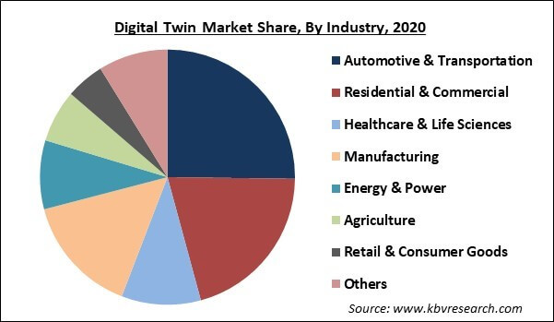
Digital twin market and industries
Physically large projects: Buildings, bridges and other complex structures bound by strict rules of engineering.
Mechanically complex projects: Jet turbines, automobiles and aircraft. Digital twins can help improve efficiency within complicated machinery and mammoth engines.
Power equipment: This includes both the mechanisms for generating power and transmitting it.
Manufacturing projects: Digital twins excel at helping streamline process efficiency, as you would find in industrial environments with co-functioning machine systems.

Slide 19
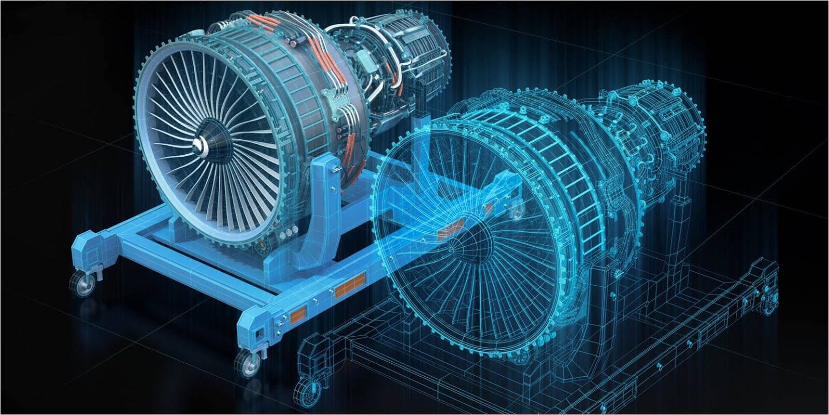

Applications of digital twins
Digital twins are already extensively used in the following applications:
Power-generation equipment: Large engines—including jet engines, locomotive engines and power-generation turbines—benefit tremendously from the use of digital twins, especially for helping to establish timeframes for regularly needed maintenance.
Structures and their systems: Big physical structures, such as large buildings or offshore drilling platforms, can be improved through digital twins, particularly during their design. Also useful in designing the systems operating within those structures, such as HVAC systems.

Slide 20
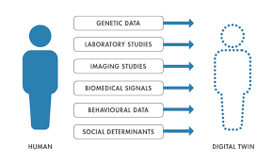
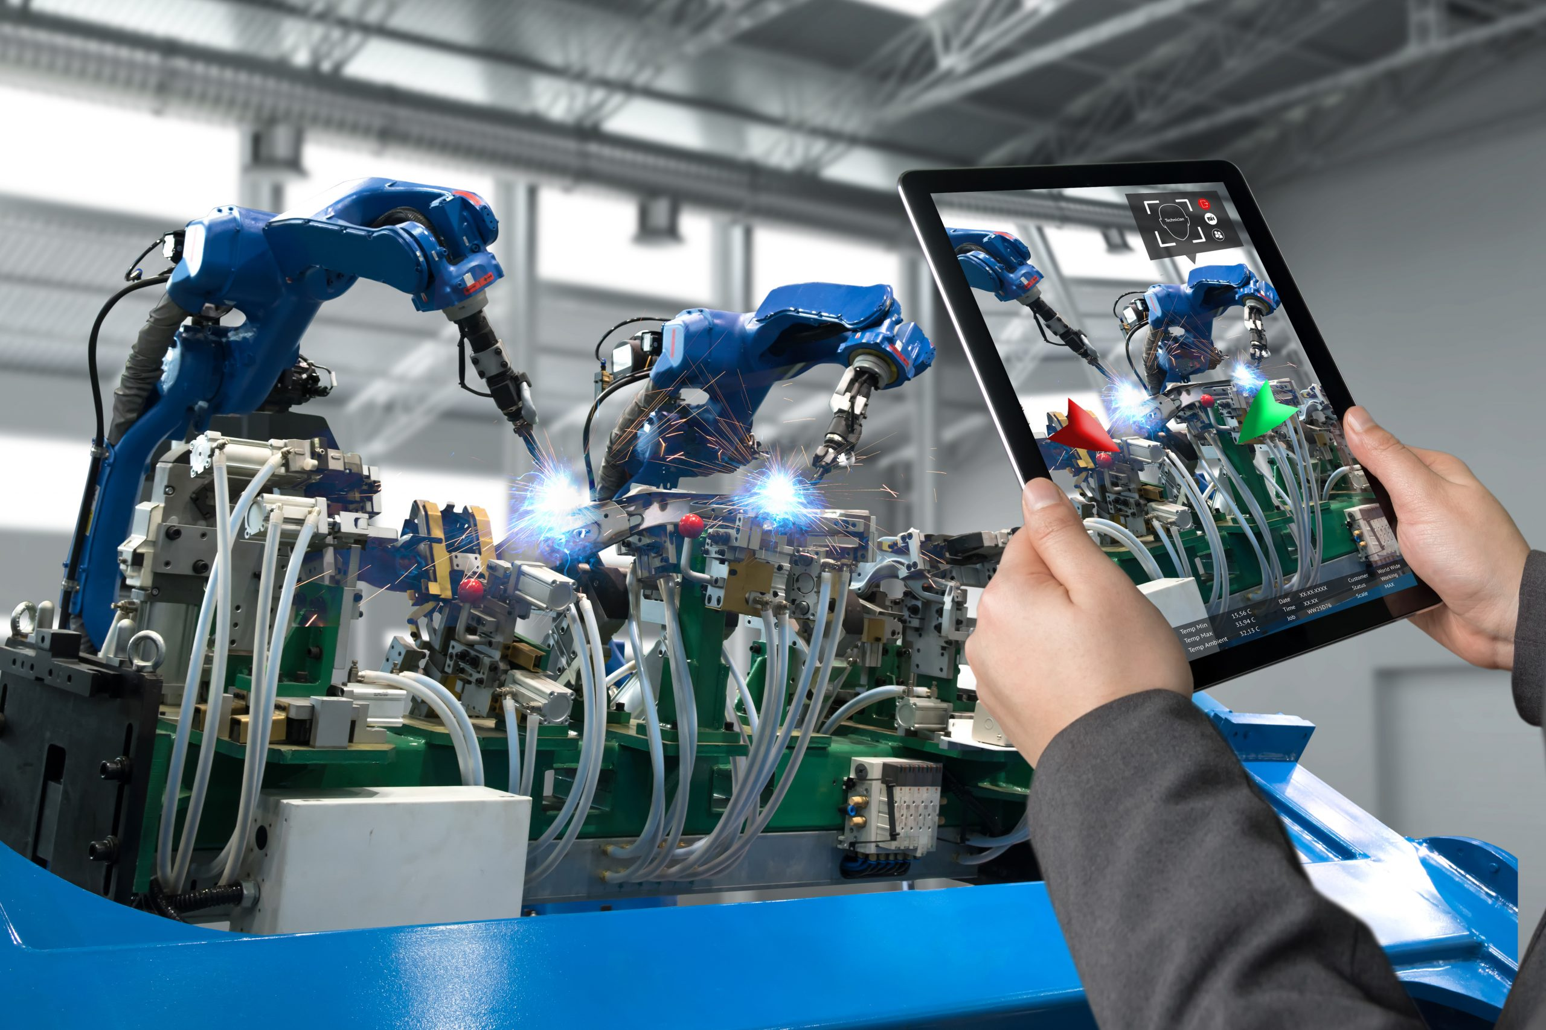
Applications of digital twins
Digital twins are already extensively used in the following applications:
Manufacturing operations: Since digital twins are meant to mirror a product’s entire lifecycle, it’s not surprising that digital twins have become ubiquitous in all stages of manufacturing, guiding products from design to finished product, and all steps in between.
Healthcare services: Just as products can be profiled through the use of digital twins, so can patients receiving healthcare services. The same type system of sensor-generated data can be used to track a variety of health indicators and generate key insights.

Slide 21
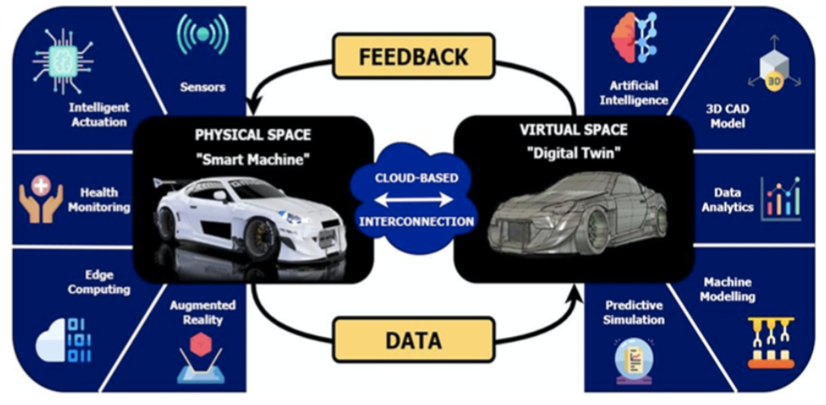
Applications of digital twins
Digital twins are already extensively used in the following applications:
Automotive industry: Cars represent many types of complex, co-functioning systems, and digital twins are used extensively in auto design, both to improve vehicle performance and increase the efficiency surrounding their production.
Urban planning: Civil engineers and others involved in urban planning activities are aided significantly by the use of digital twins, which can show 3D and 4D spatial data in real time and also incorporate augmented reality systems into built environments.

Slide 22
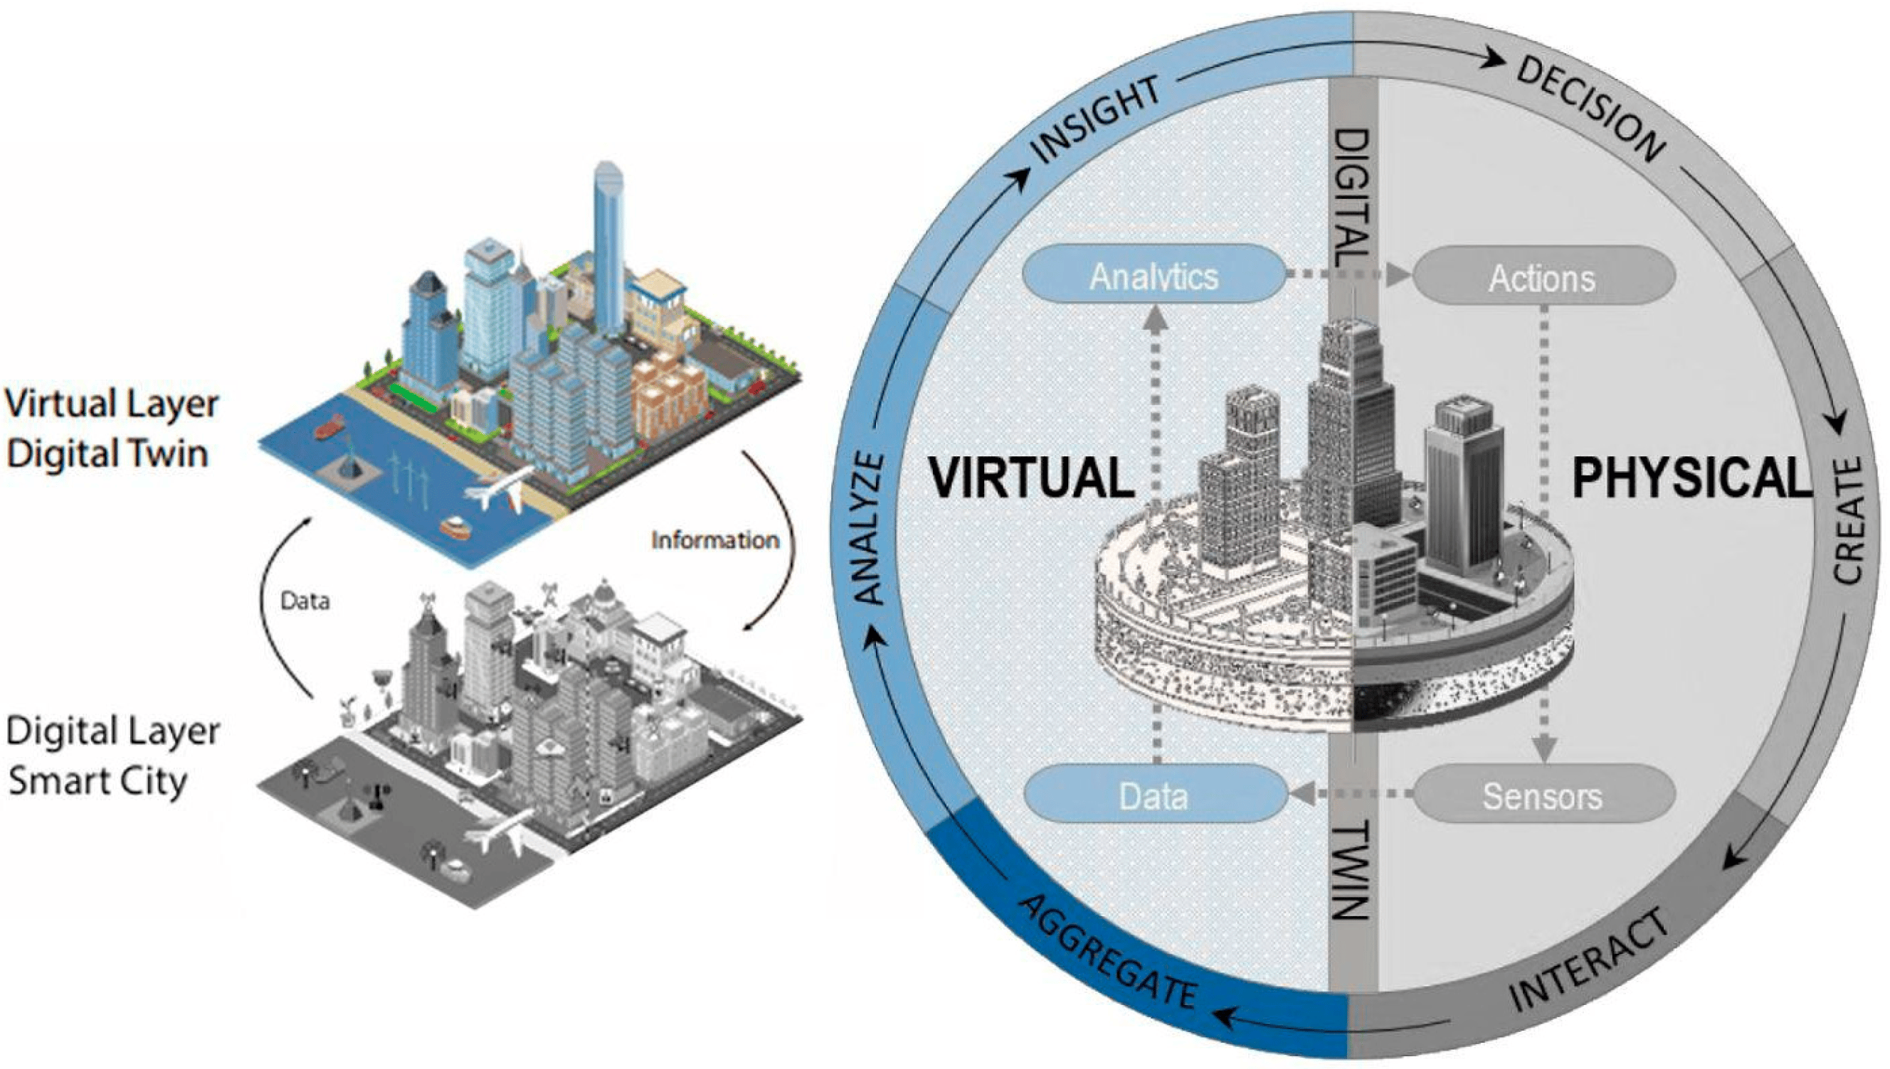
Applications of digital twins
Digital twins are already extensively used in the following applications:
Urban planning: Civil engineers and others involved in urban planning activities are aided significantly by the use of digital twins, which can show 3D and 4D spatial data in real time and also incorporate augmented reality systems into built environments.

Slide 23
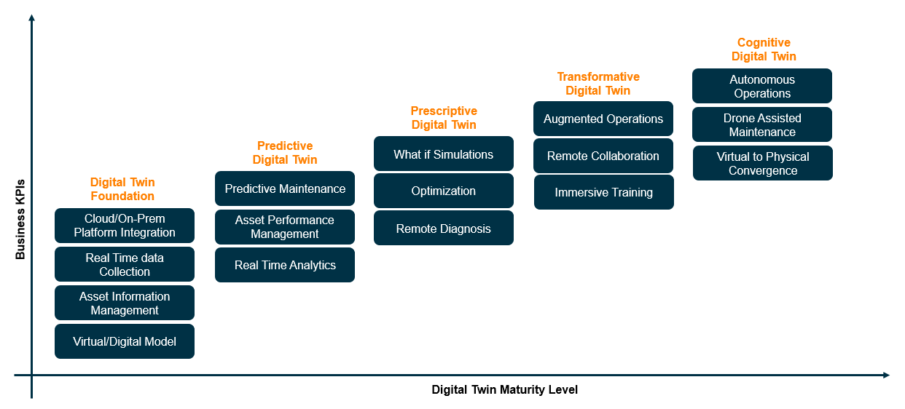
The future of digital twin
The future of digital twins is nearly limitless, due to the fact that increasing amounts of cognitive power are constantly being devoted to their use. So digital twins are constantly learning new skills and capabilities, which means they can continue to generate the insights needed to make products better and processes more efficient.

Slide 24
Thank You

